Slide 1
Gap Analysis
By: Jacob Igel & Samuel Vaughan

Slide 2
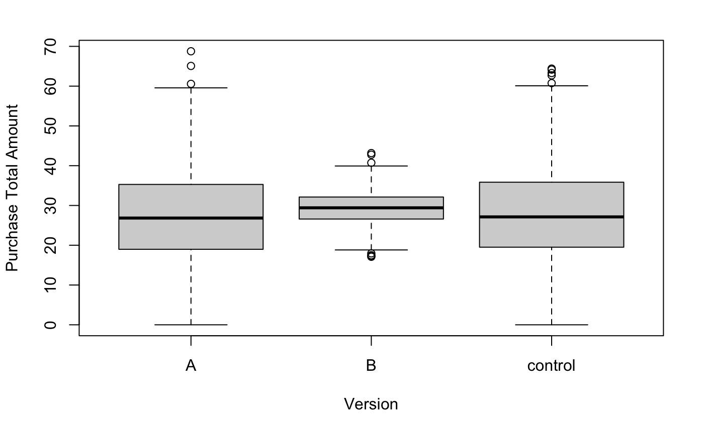
Version B Is The Best Version
We can conclude that Version B is the best version and has less variance than Version A and the Control.
However, Version A and the Control have a higher variance, meaning that it could be better than B at some things, but also could be significantly worse.
B is the best choice here and has the higher average purchase total compared to A or the Control.

Slide 3
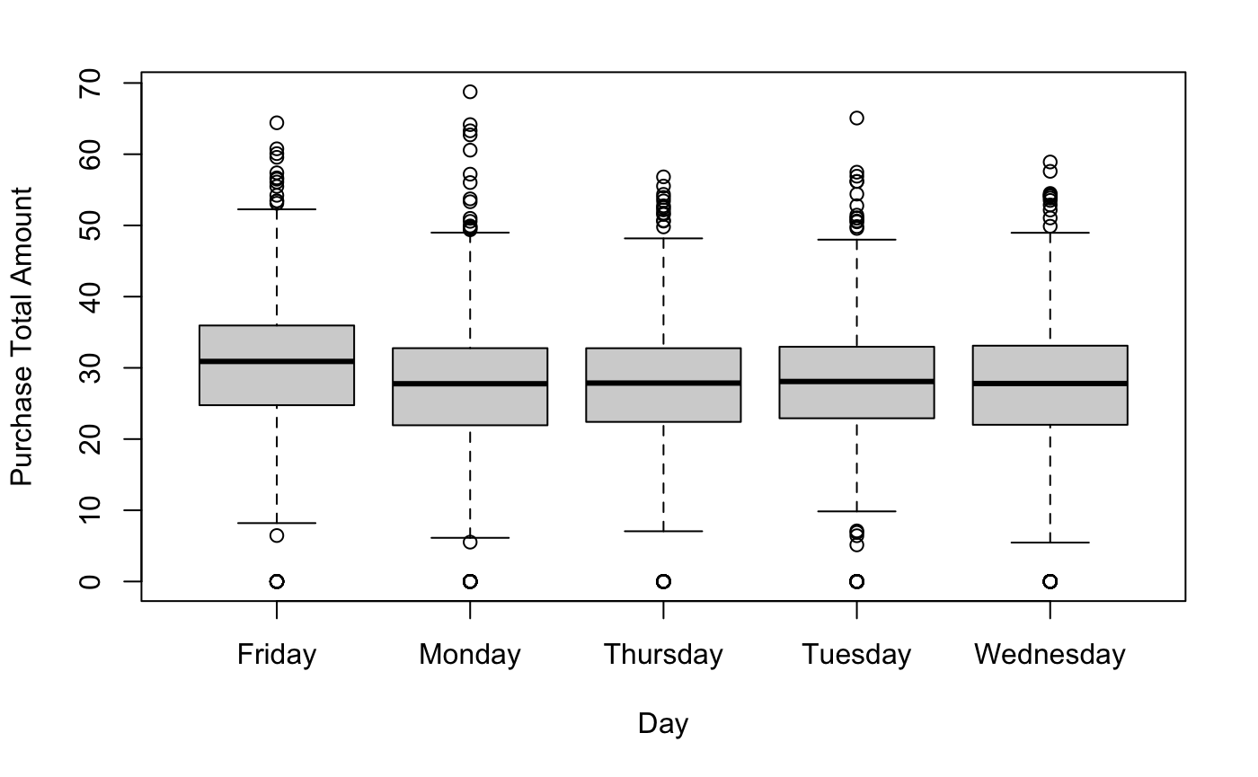
Friday Is The Best Weekday
Whenever we compared all of the weekdays with each other using a Tukey Test, we found that Friday was the best day of the week in terms of total sales.
Friday is the best weekday compared to the rest of the days of the week.

